Slide 1

How to make frames and infer people
Converting Light to Pixels
Vo, Huynh Quang Nguyen – Process and Equipment Engineer/Deep Learning Scientist

Slide 2
Agenda
About Intel Vietnam: creating a better future
From Goliath to David: the rise of vision processing units (VPU)
Human Vision: inspired by biology, implement technology
From Light to Pixels: journey to the ‘world of black magic’
Why it matters: how we can best infer people?

Slide 3

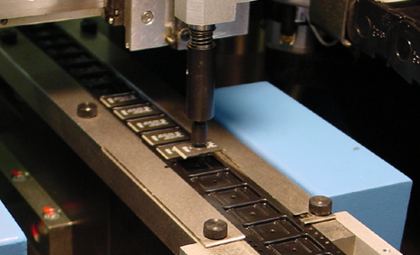
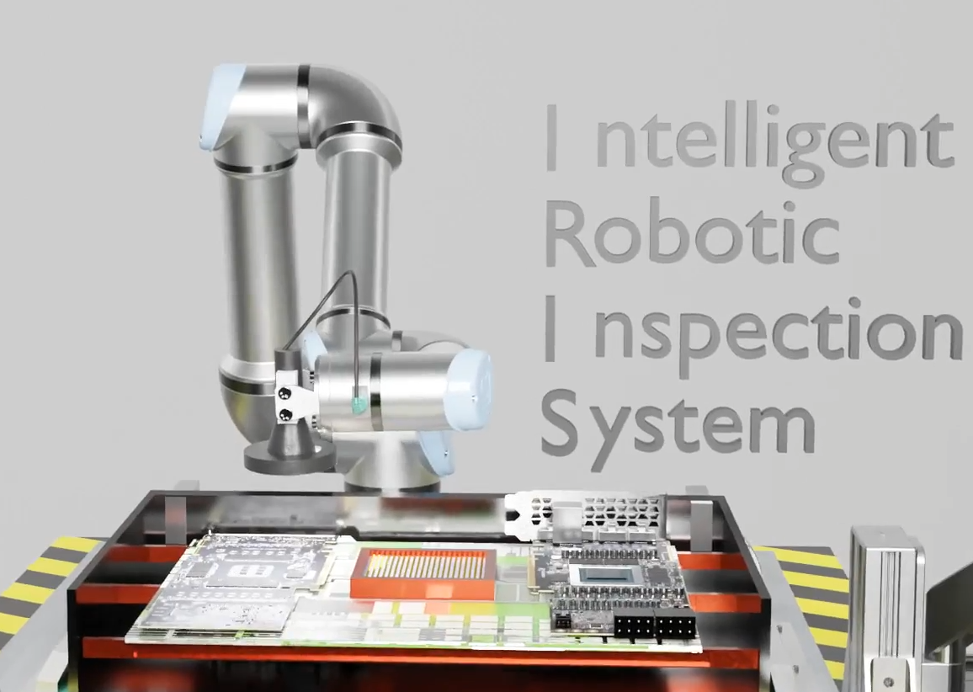
Introduction
Name: Vo, Huynh Quang Nguyen
Tel: +84(0) 396 957 043
Email: huynh.quang.nguyen.vo@asu.edu
Working Experiences:
Apr’21 – Dec’22: Intel - Process and Equipment Engineer/Deep Learning Scientist
Develop automated inspection systems for downstream operations as a portfolio lead in Computer Vision and Machine Learning.
Provide technical training in data science as a member of Intel AI and Intel Image Analytics Center of Excellence.
→ Currently on voluntary leave (VSP) to focus on pursuing a doctorate in Data Science and Computer Vision, and MBA.
Jun’21 – now: AI Vietnam - Content Creator
Author AI- and Computer Vision-related training information
Mar’19 - Feb’20: Metrology Research Institute, Aalto University – Research Assistant
Conduct optical technology measurement and device calibration
Education:
2018 - 2020: M.Sc. – Smart System Integration/Measurement Technology
2014 – 2018: B.Sc. – Electrical Engineering and Electronics

Slide 4
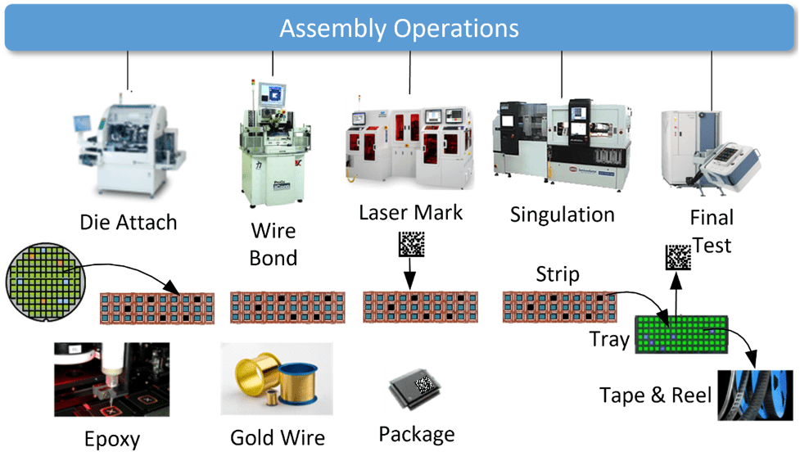
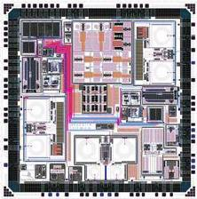
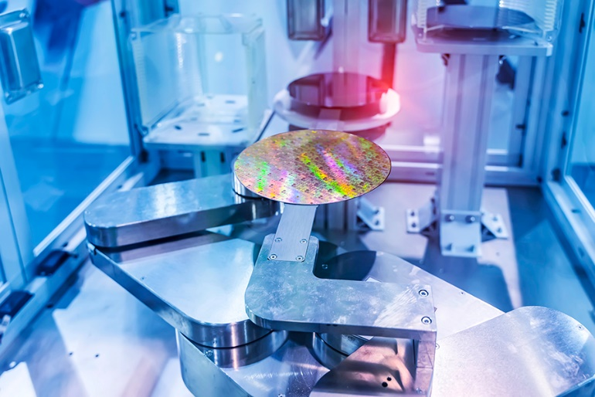
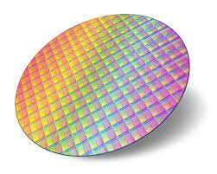
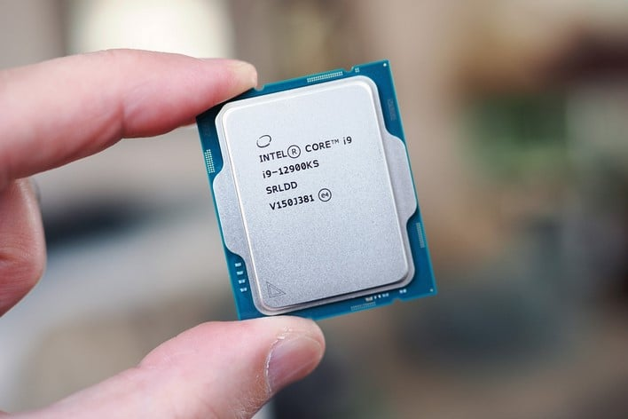
About Intel Vietnam
What we do: responsible for assembly/test of semiconductor devices.
Chip Assembly and Test
Chip Design
Chip Fabrication

Slide 5
From Goliath to David
The rise of vision processing units (VPU)

Slide 6
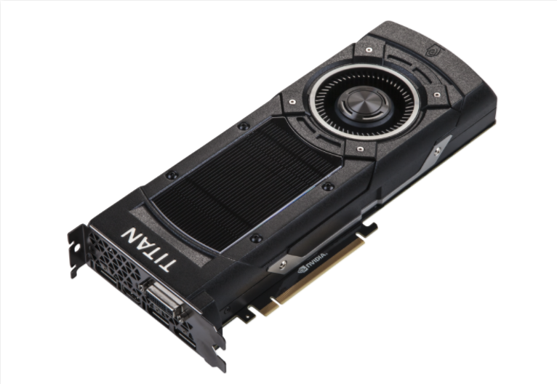
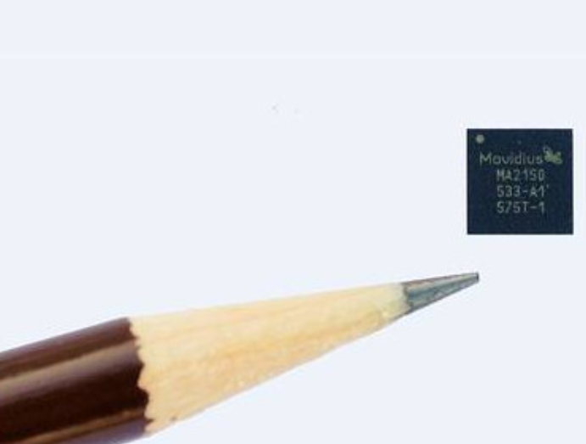

From Goliath to David
Motivation: we need to do lots of computer vision and deep learning tasks on the fly (drones, cameras, self-driving cars, etc.).
Challenge: how can we transform a high-end graphic card (GPU) into something having a small footprint?
Before
After

Slide 7
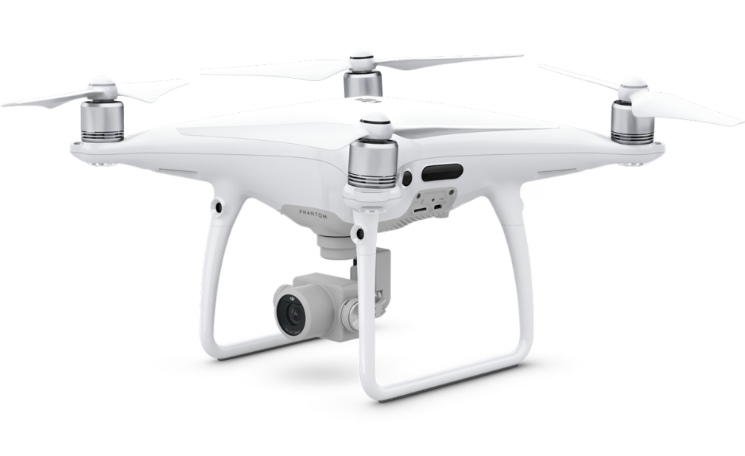
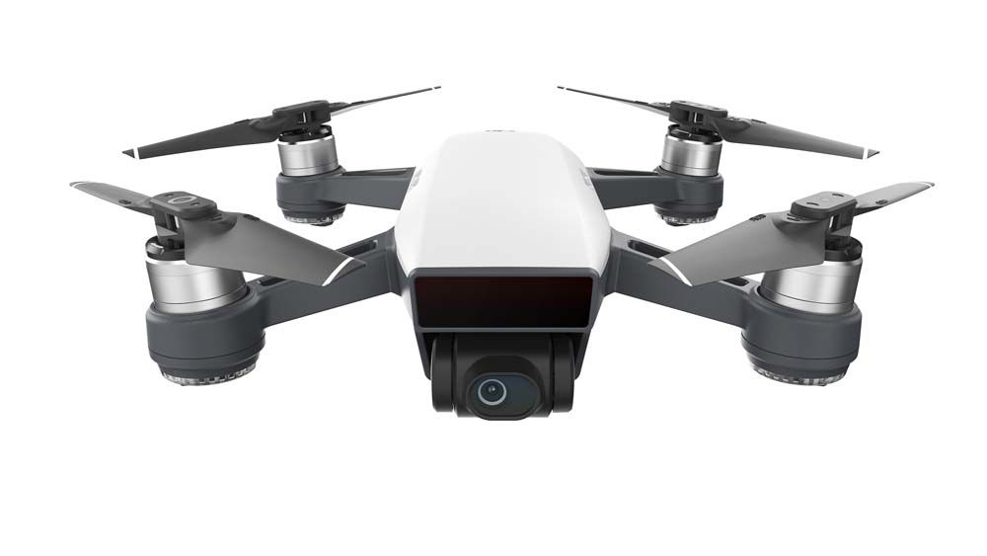
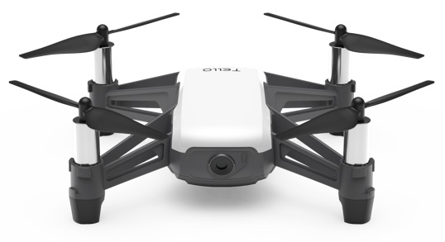
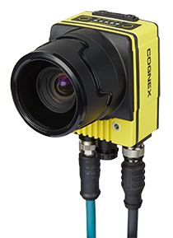
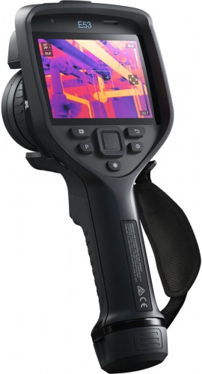
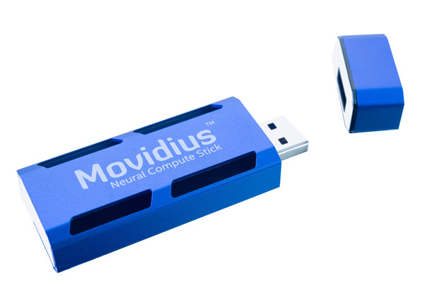
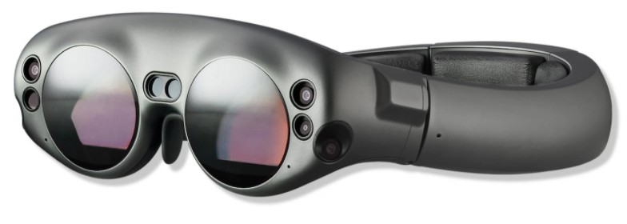
From Goliath to David

Slide 8
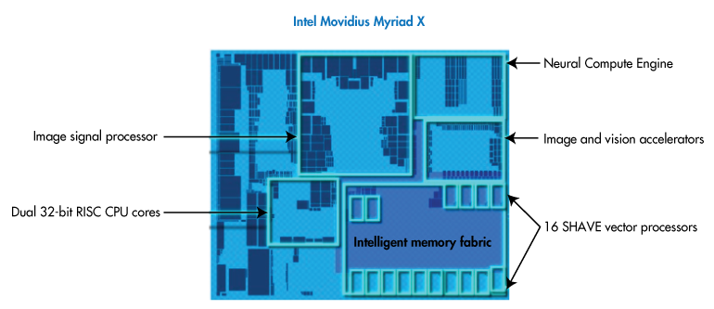
From Goliath to David
How: implement dedicated hardware for vision tasks.
Note: search for “Intel Myriad X Layout” for further information.
Notes:
Jargon Explanation:
1. Neural Compute Engine (NCE): dedicated hardware to run deep neural networks (DNNs).
2. Image Signal Processor (ISP): get inputs from multiple camera to generate output signals (images).

Slide 9
Human Vision
Inspired by biology, implement technology

Slide 10

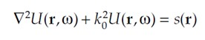
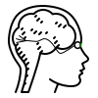
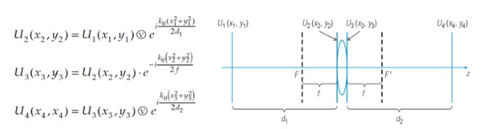
Human Vision
In summary:
Physics + Mathematics.
Cognitive science (how the brain ‘imagine’ perception).
Note: search for “Overview of light propagation on free space/through lenses” for further information.

Slide 11
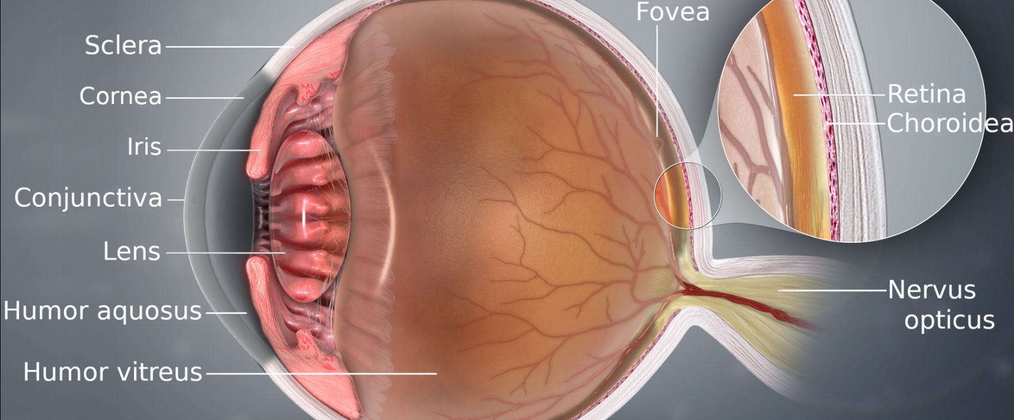
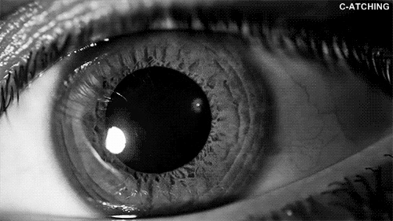
Human Vision
Anatomy of a human eye:
Most vision systems are more or less a replication of a human eye.
Notes:
More context
Our eyes are a marvel of engineering. We have good photo receptors (retina), lenses capable of changing, and an adaptable aperture. Sometimes, it makes us wonder whether there is indeed a higher-being creator that manages to accomplish this.

Slide 12
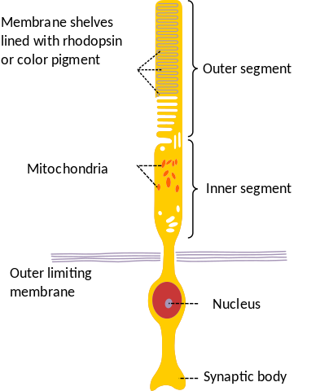
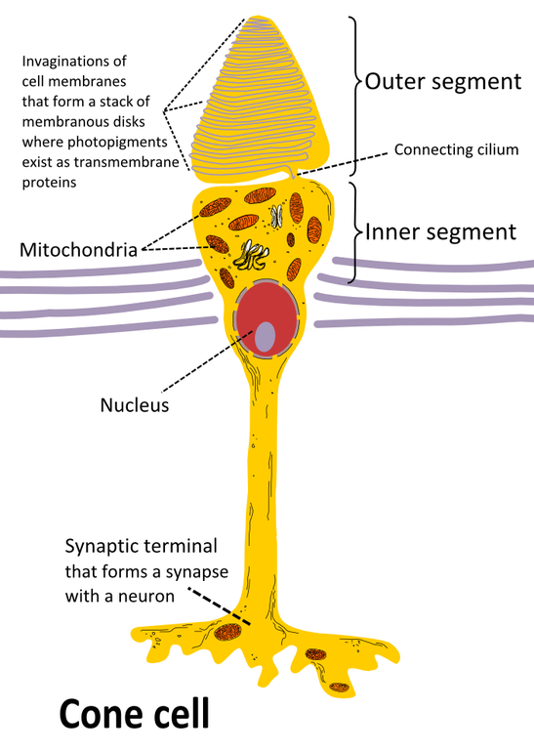
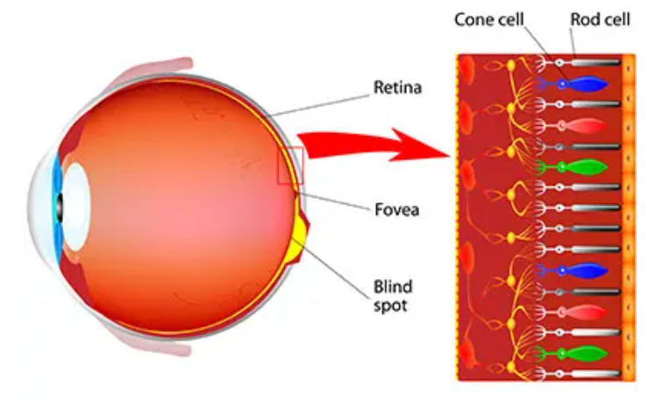
Human Vision
Anatomy of a human eye (cont.):
Rod and cone cells detect light (pigment) and brightness.
Notes:
More context
We have two types of cells that are capable of detecting light and brightness: a rod cell, and a cone cell. We call these cells such because of their shapes: one has a long cylindrical shape like a rod; the other has a conical shape at one end.
The rod cell detects colour intensity, the cone cell detects the colour of incoming light by absorbing corresponding wavelengths. Hence, rod cells are estimated to be 500 to 1000 times more receptive than cone cells.
Simply put, we can imagine rod cells are responsible for generating a grayscale image (from darkest to brightest) of our world. Meanwhile, the cone cells are responsible for ‘assigning’ appropriate colours to our image thanks to the inside colour pigments.

Slide 13
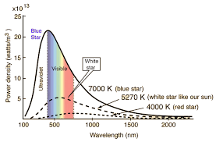
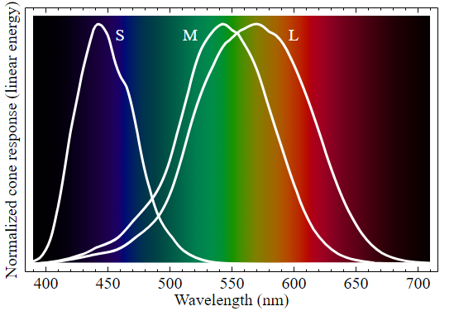
Human Vision
Anatomy of a human eye (cont.):
Cone Cell Colour Responsivity.
Note: the reasons why human are most sensitive to greenish light can be derived from the black-body radiation (Planck’s law).
Notes:
More context:
Biologists say we have 60% red-green sensing cones, 30% green-blueish/green sensing cones, and 10% blue-sensing cones. Thus, we have up to 90% green sensing cones, which is why we are hyper-sensitive to green and its derivative colour.

Slide 14
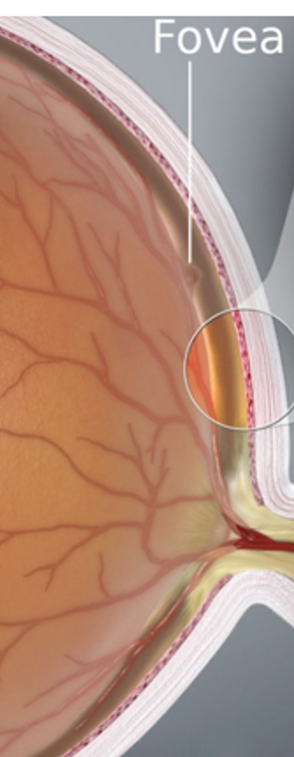
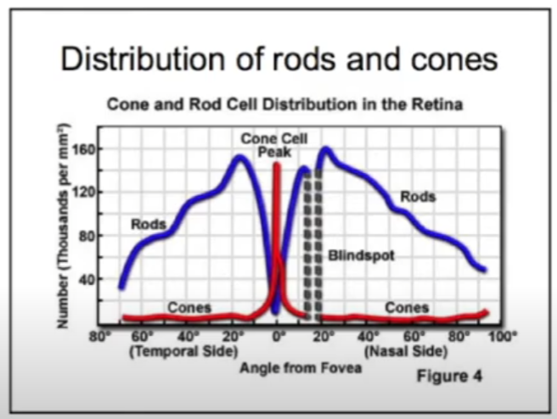
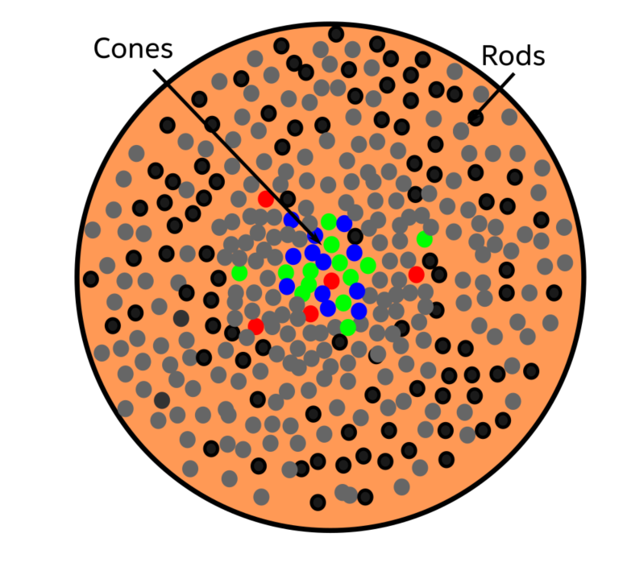
Human Vision
Anatomy of a human eye (cont.):
Cone and Rod Cells Colour Distribution in the Retina.
Notes:
More context:
Most of the cone cells are concentrated in a tiny region called the fovea in the retina. This means we can only see colours in a very narrow region of vision.

Slide 15
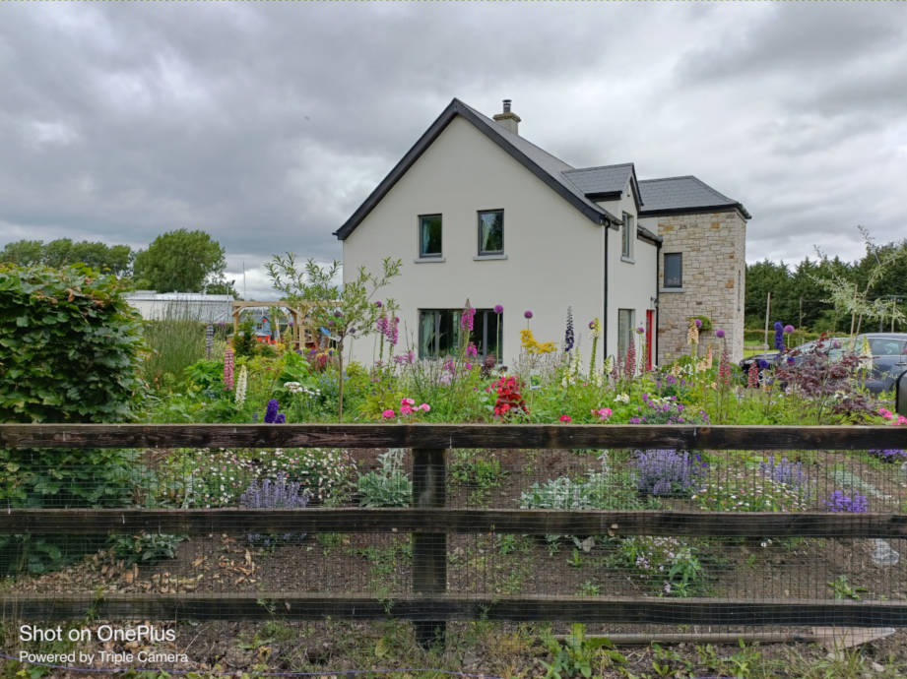
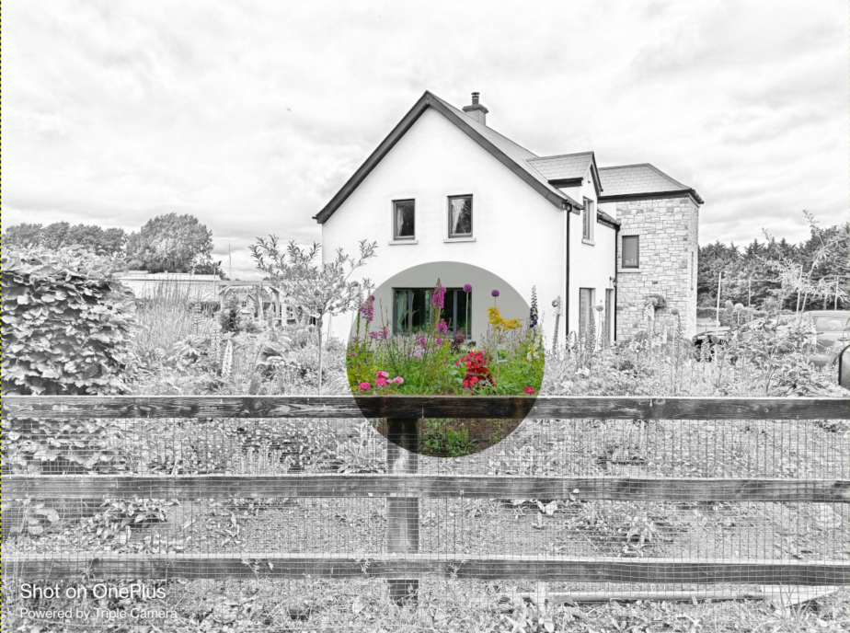
Human Vision
Anatomy of a human eye (cont.):
What we see (in our brain)
What we should have seen (ground truth)
Notes:
More context:
Judging by the small distribution of our cone cells, the things that we have seen in real life (ground truth) only have a small fraction of coloured region in our field of vision, while the rest is grayscale. Yet, we see everything with colours in our field of vision. How is it possible?
The short answer is our brain ‘tricks’ us by filling in the gaps.

Slide 16
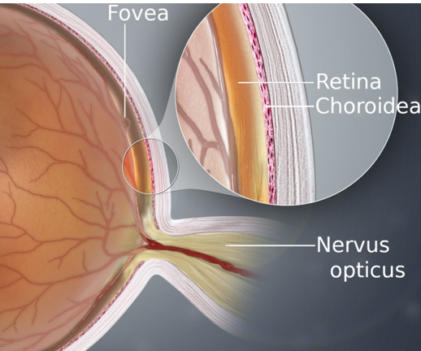
Human Vision
Anatomy of a human eye (cont.):
Retina behind the supplying blood vessels.
Neural links located in the middle of the eye.
Notes:
More context:
In addition to the disparity of distribution between the rod and cone cells, our eyes have two additional problems:
First, the retina is behind its supplying blood vessels. In other words, it is similar to putting the circuitry on the sensor. If we make a tiny hole in a piece of paper, hold it up to the light (e.g., a candle), and then move it around our eyes, we can cast shadows on these veins and see them. These veins are all over our vision, yet we cannot see them. All thanks to our brains!
Secondly, the wires connecting the eyes and the brain are located right in the middle of our vision. So in reality, we have a giant blind spot in our field of vision. Again, we don’t see it because our clever brain edits it out!

Slide 17



Human Vision
Anatomy of a human eye (cont.):
The best analogy of our eyes
Photosensitive sensor
Circuitry
Photosensitive sensor
‘Black hole’

Slide 18
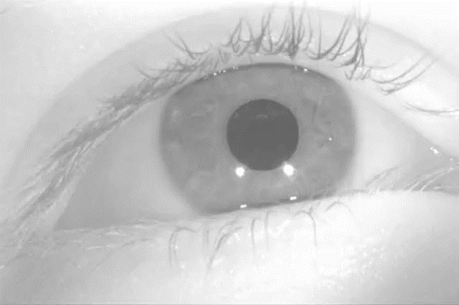
Human Vision
Anatomy of a human eye (cont.):
The eyes are continuously moving (saccading).
Notes:
More context:
When the eyes are moving, we become temporarily blinded. Thus, we spend on average 40 minutes completely blind.

Slide 19
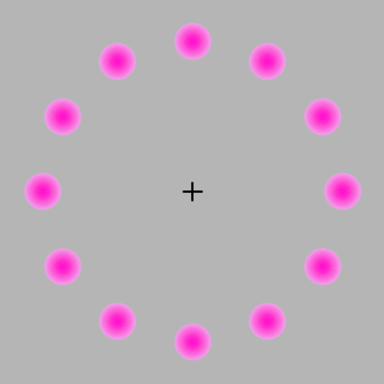
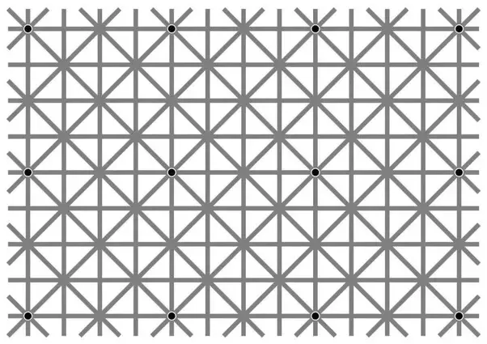
Human Vision
Anatomy of a human eye (cont.):
Test 1
Test 2
Notes:
More context:
Test 1: look at the cross in the middle of the picture and don’t move your eyes for 3-5 mins. What happens to the pink balls surrounding the cross?
Spoiler Alert: these balls will fade away eventually. Once you start moving your eyes, the balls appear right back.
Test 2: try to locate the points in the picture. What happens to them?
Spoiler Alert: you may perceive that the points are moving, but these points are stationary. There are 12 points in the picture, and you can only see a small set of them because your eyes are saccading.

Slide 20
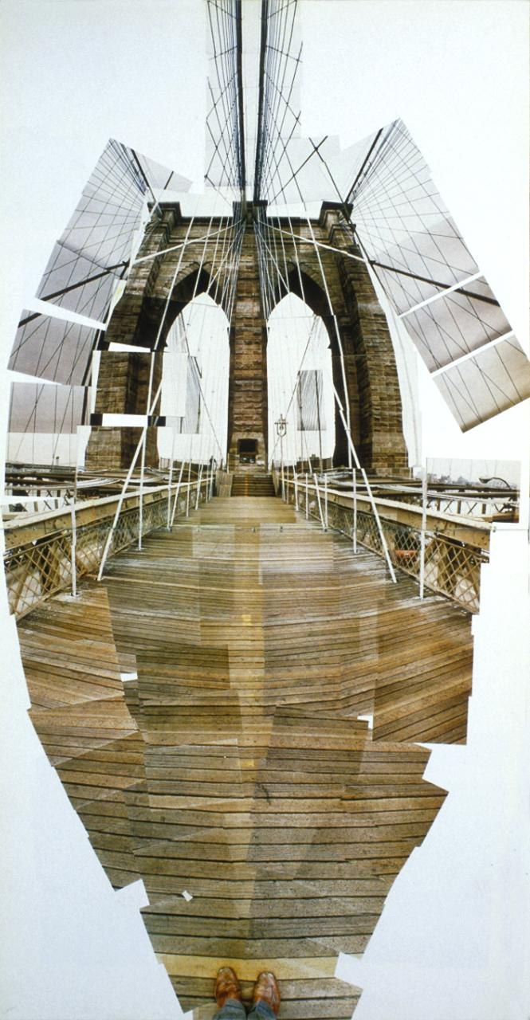
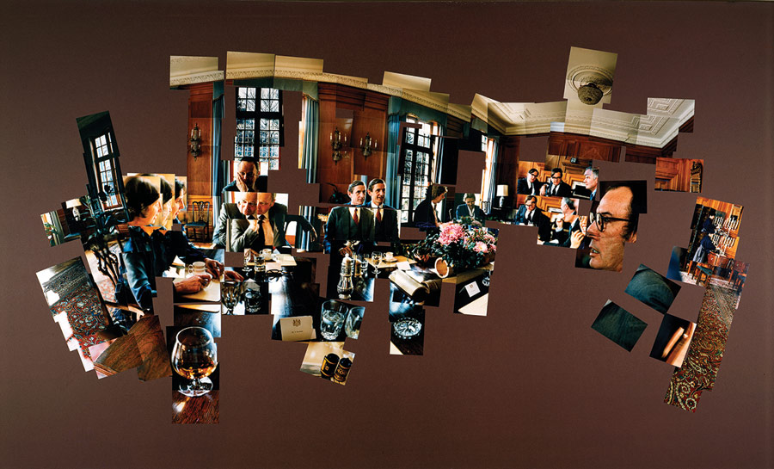
Human Vision
So far we have known that:
We have bad ‘hardware’. How do we fix it?
Our actual field of vision

Slide 21
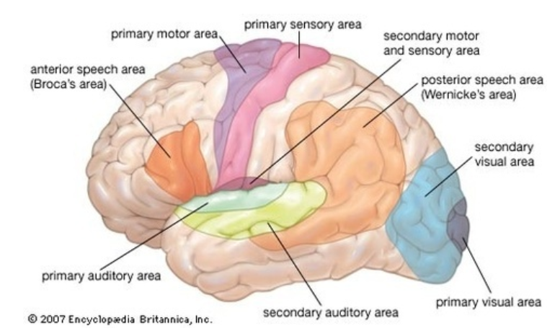
Human Vision
Solution:
Bad ‘hardware’ can be fixed with good ‘software’.
Notes:
More context:
According to biologists, 60% of our brain is involved with vision. In other words, we are visual creatures.

Slide 22
From Light to Pixels
Journey to the ‘world of black magic’

Slide 23

From Light to Pixels
Recap:
Light source.
Lens.
Photoreceptors.
Brain.
Photoreceptors

Slide 24
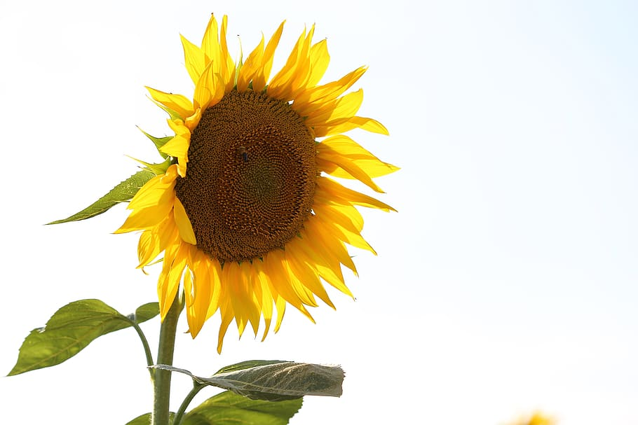
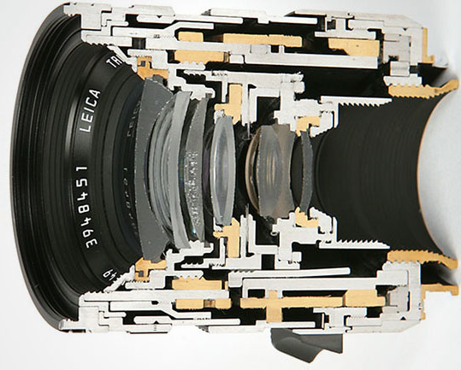
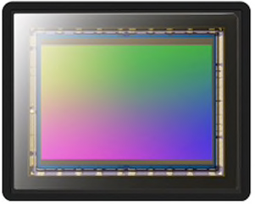
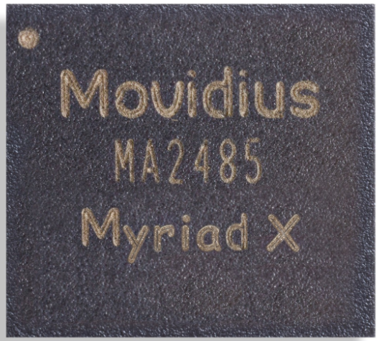
From Light to Pixels
Image quality → Amount of light in the environment. → How much light is captured.
Vision (a.k.a. Imaging or Camera) system:
Environment.
Optics (lens, aperture, shutter).
Sensors (CMOS or CCD).
Image Processor.
Notes:
More context:
In an imaging system, the image’s quality depends on the amount of light in the environment and how much of the light is captured by the camera system.
Three main components directly affect image quality are:
(1) the optics which control how much light hits the sensor, (2) the sensor (CMOS or CCD) which converts the light into electrons,
(3) the image processor - consisting of an Analog-to-Digital converter (ADC) and an image signal processor (ISP) - which converts the electrons into numerical colour values.
Using this framework (environment, optics, sensor, image processor), we can examine the variables that affect the image quality and at what stages they occur.

Slide 25



From Light to Pixels
Environment:
Direction of Light to the camera.
Direct Light
Diffuse/Ambient Light
Notes:
Direct Light: light rays propagate directly into the system
Diffuse/Ambient Light: light rays bounce multiple times across the scene before propagating into the system.

Slide 26
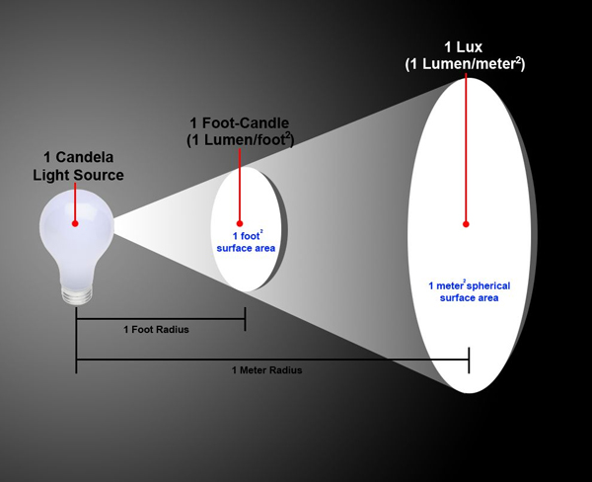
From Light to Pixels
Environment (cont.):
Measuring light brightness: lux = lumens per square meter.
Bright sunlight: > 100,000 lux.
Cloudy day: 1000 lux.
Overcast (thunderclouds): 100 lux.
Note: search for ‘how lumen is defined’ to understand how we measure light intensity.
Notes:
More context:
Interestingly, we use a candle as our reference point for lumen (1 lumen = 1 candela x 1 square radians).
Fun fact: the farthest distance a human eye can detect a candle flame is 2.76 kilometers.

Slide 27
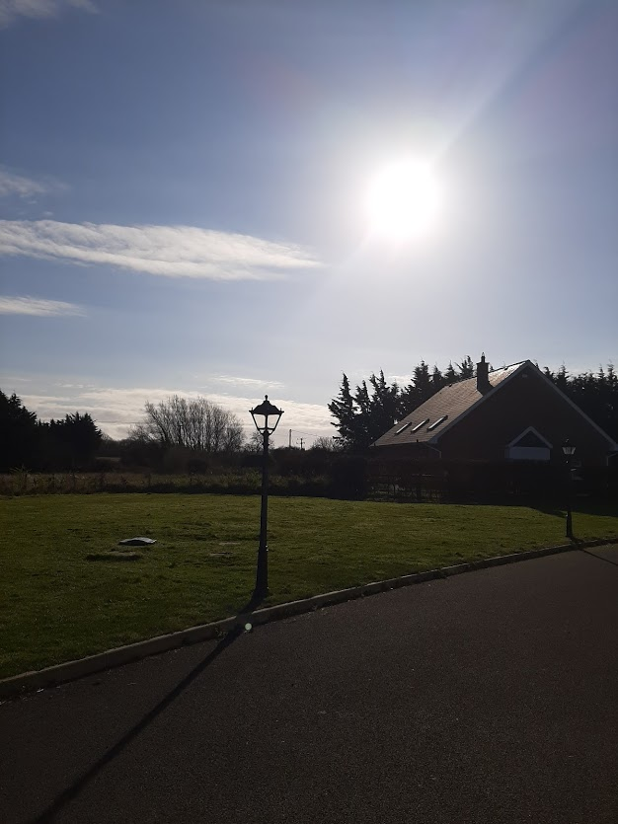
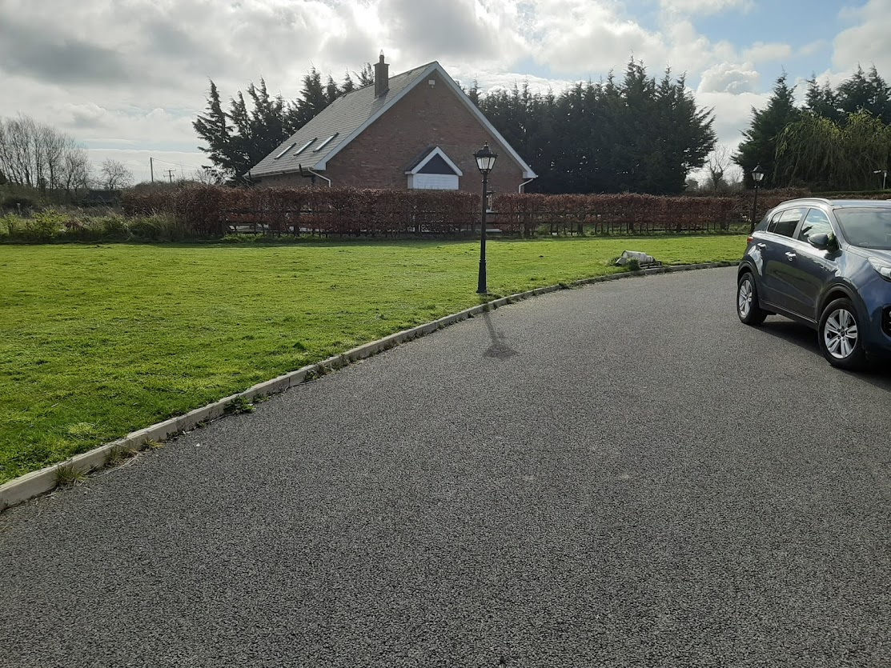
From Light to Pixels
Environment (cont.):
Direct light alters the textures of an image.
Notes:
More context:
When we point our camera directly at the light source – our sunlight, which is about > 100,000 lux – the regions near the light source will be over-exposed while other regions are under-exposed.
We can start seeing the textures if we use the software to compensate. For example, we can see that the road has a different texture than the grass. We can see that the lamppost casts a shadow on the road. We can see the reflections from the car, etc.

Slide 28
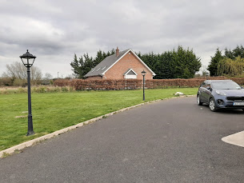
From Light to Pixels
Environment (cont.):
Diffuse/ambient light also alters the textures of an image, in a different way.
Notes:
More context: When our camera only captures diffuse/ambient light, we can clearly see there is a massive drop in brightness.
Overall, the textures of our image become smoother.

Slide 29
From Light to Pixels
Environment (cont.):
Direct light vs. Diffused light = dictates what we want to see.
40,000 lux (lumens per square meter)
1,000 lux (lumens per square meter)
Notes:
Direct light vs. Diffused light. The type of lighting conditions dictates what we want to see.

Slide 30
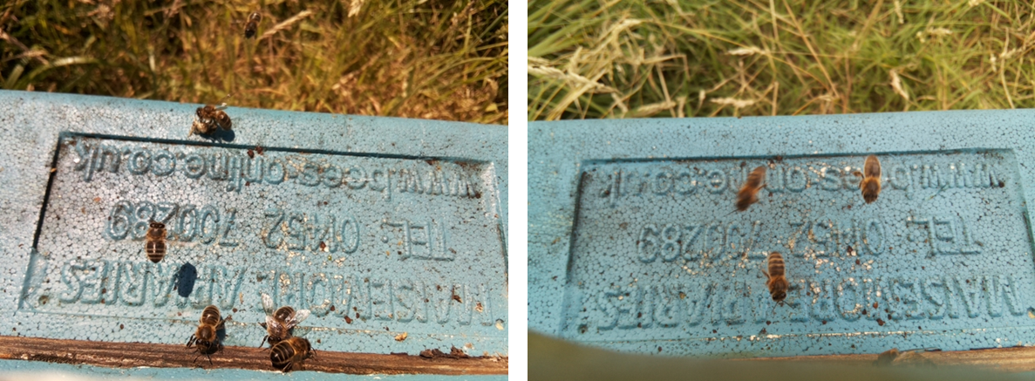
From Light to Pixels
Environment (cont.):
Movement: to increase the amount of light, we need to (1) increase the exposure time, or (2) increase the aperture → blur fast-moving objects.

Slide 31
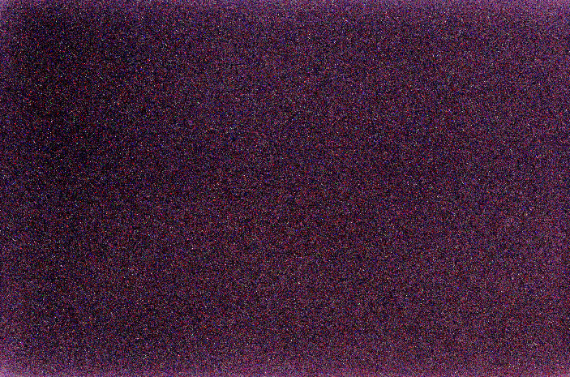
From Light to Pixels
Environment (cont.):
Temperature: from everywhere (ambient, camera, etc.).
Image generated by dark current (completely darkness according to our visual perception).
Notes:
More context: According to Planck’s Law, everything that has a temperature greater than 0 K (Absolute Zero) emits radiation in the form of photons. Since our photo sensors are hyper-sensitive, they can capture photons emitted from any object, ranging from the surrounding environment to the camera.
Additionally, our sensors are semiconductor devices meaning their performance is significantly affected by their operating temperature, which in turn is affected by the environmental temperature.

Slide 32
From Light to Pixels
Summary of environmental factors:
Direct light.
Diffused / Ambient light.
Camera movement.
Camera Temperature.
Dark current.
Particles and Moisture.
Notes:
A direct light source can illuminate features on an object but will also cast shadows. Moreover, if the light rays directly strike the lens, it can also generate lens flare.
Ambient/diffused lighting in the scene will illuminate all objects equally but will also diffuse (a.k.a. blur) the edges of features.
Movement: if either an object or the camera moves while the light is being recorded by the sensor then the image will be blurred.
Camera temperature: semiconductor devices, such as a camera sensor, are affected by ambient radiation (a.k.a. heat).
Dark current is residual current in a photoelectric device when there is no illumination. More dark current will be generated as the heat increases. The result is noise in the image.
Particles and moisture in the air: dust and moisture can reduce the amount of ambient light and obscure light from the target object from reaching the sensor.

Slide 33
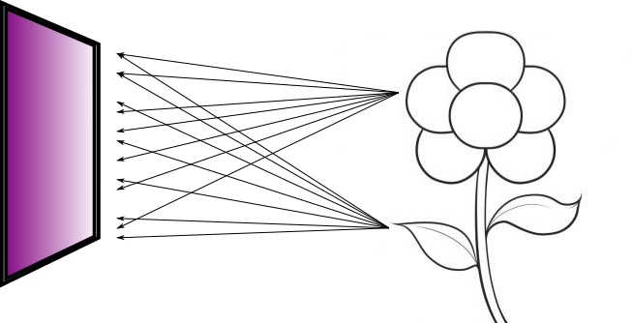

From Light to Pixels
Optics - lenses:
Optics help us control the amount of light arriving to the sensor.
No optics = blur image
With optics = crisp image
Notes:
More context: Why do we need optics? Light propagates in the free space thus hitting the object (e.g., a flower) and then bouncing in multiple directions. Imagine that we expose a sensor to capture these bouncing light rays to create an image of our flower. What we get is something blurry because light rays from any point in the flower are spreading all over the sensor. Thus, we need optics (e.g. just a tiny hole) to limit the number of light rays.

Slide 34

From Light to Pixels
Optics – lenses (cont.):
The most basic optics is just a pinhole → pinhole camera/camera obscura.
Note: every camera system can be explained using pinhole camera as the mathematical model.
Notes:
More context:
How the pinhole camera model works:
(1) Diameter of the hole affects the clarity of the image on the projection screen: the smaller the hole, the sharper the image. However, once the hole reaches a critical small size, the image becomes fuzzy due to light interference. (2) The size of the image depends on the distance between the screen and the optics (focal length): the further the screen to the optics, the larger the image.

Slide 35

From Light to Pixels
Optics – lenses (cont.):
Lenses are basically a more optimized way compared to pinholes to control the amount of light coming to the sensor.
Notes:
More context:
The purpose of the lenses is to collect scattered light rays from the object and focus them back on the same spot in the sensor.

Slide 36



From Light to Pixels
Optics – lenses (cont.):
Lenses have trade-offs: distortion and aberration.

Slide 37



Pincushion
Barrel
From Light to Pixels
Optics – lenses (cont.):
Geometric distortion.
Note: barrel distortion is employed in fisheye lens.
Notes:
More context:
Geometric distortion commonly occurs from aberrations near the edges of an image. It is usually caused by miscommunication between the sensor and the lens.
For barrel distortion, the reason is that the field of view of the lens is wider than the image sensor. Thus, the image looks like it has been squeezed and constricted to fit in the edges of the frame.
For pincushion distortion, the reason is due to the increased magnification on parts of the image closest to the edge of the frame.

Slide 38


Pincushion
From Light to Pixels
Optics – lenses (cont.):
Geometric distortion.
curves inward
curves outward
Barrel
Notes:
More context:
Pincushion distortion is where straight lines bend inward to the centre of the image. Pincushion commonly occurs in the telephoto lens (e.g., Nikon 70-200 mm).
Barrel distortion is where straight lines bend outward from the centre of the image. Barrel distortion commonly occurs in the wide-angle lens (e.g., Nikon 24-70 mm lens).

Slide 39



From Light to Pixels
Optics – lenses (cont.):
Chromatic aberration/colour fringing.
focal plane
optical axis
Notes:
More context:
Chromatic aberration: when a light ray travels from one medium (free space) to another (lens), it will be diffracted because there is a mismatch in refractive index between two media. Each wavelength of light will be diffracted differently.

Slide 40



From Light to Pixels
Optics – lenses (cont.):
Chromatic aberration/colour fringing.
Lateral Chromatic Aberration
Axial Chromatic Aberration
Notes:
More context:
Lateral Chromatic Aberration: basically, different wavelength focuses at different distances along the optical axis. It is easy to fix this type of aberration.
Axial Chromatic Aberration: basically, different wavelength focuses at different positions along the optical plane. It is much harder to fix this type of aberration.

Slide 41



From Light to Pixels
Optics (lenses):
Field of view (FOV) distortion.
Notes:
More context:
Each lens has a different field of view (FOV), and that leads to distortion. This distortion leads to a zooming effect on the captured image.
A large FOV lens is good for tracking (e.g., object tracking).
A small FOV lens is good for low distortion, flare control, and cost reduction.

Slide 42

From Light to Pixels
Optics – lenses (cont.):
Lens Shading/Light fall-off /Vignetting.
Note: this jargon is derived from decoration of images in the 18th -19th century (putting decorations around the edge, a.k.a. vignetting
Notes:
More context:
Vignetting: the edges look darker than the rest of the image. The reason is that at the edge of the lens, less light is coming to the sensor.

Slide 43



From Light to Pixels
Optics – aperture:
Notes:
More context:
The size of the aperture is determined by the ratio between the focal length and a constant. Hence, the smaller the constant the greater the diameter. The constant here is determined as an exponent of the square root of 2 - sqrt(2)^n.

Slide 44

From Light to Pixels
Optics – aperture (cont.):
Depth of field.
smaller
larger
Notes:
More context:
Smaller aperture – greater depth of field: you can see both foreground and background.

Slide 45


From Light to Pixels
Optics – shutter:
Control how much light hits the sensor.
Two types of shutter: rolling, and global
Rolling shutter
Notes:
More context:
Rolling shutter operates similarly to a blinder: the light will be blocked line by line.
Global shutter operates similarly to a curtain: the light will be completely blocked.

Slide 46


From Light to Pixels
Optics – shutter (cont.):
The shutter speed determines how fast of a movement we can capture.
The types of the shutter may affect the output image.
Notes:
More context:
If the shutter speed is slower than the movement speed, what we get is some weird artefacts.
A global shutter is used for capturing moving objects while a rolling shutter is used for capturing still images. Hence, high-end cameras capable of capturing moving objects in nanoseconds employ a global shutter, while normal DSLR cameras opt for primarily rolling shutters.

Slide 47
From Light to Pixels
Summary of optics factors:
Lens distortion.
Lens aberrations.
Field of View.
Vignetting.
Aperture & depth of field (DOF).
Shutter (rolling, global).
Notes:
More context:
(1) Lens Distortion: the sole purpose of a lens is to focus more light onto the sensor. It accomplishes this by bending the light it captures inwards onto the sensor. This results in a geometric distortion of the resulting image.
(2) Lens aberrations: the result of defects during manufacturing processes; it introduces noise and distortion into the image. While geometric distortions can be remedied easily through mathematical modelling, lens aberrations cannot.
(3) Aperture: the aperture controls the amount of light that can reach the sensor. A large aperture will allow more light to reach the sensor and reduce shutter times but there will be a shallower depth of field, i.e., the light entering the sensor will be diffuse and blurring will occur in the background and foreground. A small aperture will require longer shutter times but the light will be collimated, i.e., the light rays will be parallel. Collimated light results in a greater depth of field.
(4) Shutter: the shutter controls the amount of time that the sensor captures light. In modern electronic equipment, the shutter is normally electronic but mechanical shutters are still used in high-end equipment. There are two main types of shutter systems, global and rolling. The light to the sensor can be entirely blocked (global) or line by line (rolling). Rolling shutters can cause skew and warping defects due to the scene changing as the information is recorded while global shutters have a lower frame rate. The type of shutter is normally dependent on the sensor technology. CMOS uses a rolling shutter and CCD uses a global shutter, although there are exceptions.

Slide 48


From Light to Pixels
Sensors:
Two types: CCD and CMOS.
Charge-couple Device (CCD)
Complementary metal–oxide (CMOS)
Notes:
More context:
CCD offers incredible quality and low noise. However, it comes with a trade-off of being expensive, high power usage, and slow speed because it has one-by-one readout of pixel values.
CMOS is cheaper but noisier. Yet, it offers many advantages such as perfect readout of pixel values and low power usage.

Slide 49



From Light to Pixels
CCD
Sensors (cont.):
How CCD and CMOS works.
CMOS
Note: refer here for further explanation.
Notes:
More context:
The sensor operates under the principle of that it converts photons into electrons (a.k.a. current).
Imagine light incoming to the sensor, as soon as the shutter opens, which is identical to that of rain filling a series of buckets. In CCD, it simply is the water contents are passed along the buckets, and at the edge, the contents are read by circuitry.
In CMOS, on the other hand, each bucket comes with its measurement.

Slide 50



From Light to Pixels
Sensors (cont.):
CCD vs. CMOS in terms of size.
Size Matters!
CCD
CMOS
Notes:
More context:
Smaller size means a smaller area to capture light meaning lower quality (in terms of definition) image.
CCD is commonly employed in the telescope (e.g., the sensor behind the James Webb telescope is a giant CCD).

Slide 51


From Light to Pixels
Sensors (cont.):
Colour Filter Array, placed in front of the CCD/CMOS component.
CFA
Bayer Filter
CCD/CMOS
Notes:
More context:
The sensor can only read light intensity. Thus, if we want to read colours, we need to place a colour filter array (CFA) on top of the CCD/CMOS.
Common CFA employed is the Bayer filter. In this filter, the red/green/blue light ray is filtered to create a specific pattern accordingly. The interesting part of the Bayer Filter is that the amount of green patterns is always greater than that of red and blue. The reason for this disparity is that our eyes are hyper-sensitive to greenish colours.

Slide 52

From Light to Pixels
How a colour is generated - demosaicing:
This is our final image

Slide 53

From Light to Pixels
How a colour is generated – demosaicing (cont.):
This is what we get from the CCD/CMOS

Slide 54

From Light to Pixels
How a colour is generated – demosaicing (cont.):
This is what we get from the CFA when superimposed onto the CCD/CMOS output

Slide 55

From Light to Pixels
How a colour is generated – demosaicing (cont.):
This is what we get after interpolation (a.k.a. filling the gaps)
Cmglee / CC BY-SA (https://creativecommons.org/licenses/by-sa/3.0)

Slide 56

From Light to Pixels
How a colour is generated – demosaicing (cont.):
This is what we get after smoothing (a.k.a. removing aliasing)

Slide 57

From Light to Pixels
Sensors (cont.):
How sensors are connected:
Serial: mobile industry processor interface (MIPI®) Camera Serial Interface (CSI-2).
Parallel: CIF.

Slide 58
From Light to Pixels
Summary of sensors factors:
Sensor Type: CCD or CMOS.
Analog-to-digital Converter.
Sensor Size.
Sensitivity - ISO grain.
Colour Filter Array.
Dynamic Range.
Sharpness.
Notes:
More context:
(1) Sensor size: The size of a sensor ultimately determines how much light, and therefore information, is used to create an image. While smaller sensors can be used to output the same number of pixels, a larger sensor area will improve the dynamic range, reduce noise and improve low-light performance.
(2) Sensor type: the two primary digital sensors are Charge Coupled Device (CCD) and Complimentary Metal-Oxide Semiconductor (CMOS). CCD sensors initially dominated due to the high quality of the image and simpler fabrication techniques. As lithography technology improves, CMOS sensors took over due to their lower cost of manufacture, lower power consumption and camera-on-a-chip integration. Most sensors found in commercial products now use CMOS technology.
(3) ISO grain: it represents a digital sensor’s sensitivity to light. A high ISO means that the sensor will record photons in low light conditions but it also introduces noise on the output, called grain.
(4) Dynamic range: the range of light levels a camera can capture. Normally if a scene has a large variance in lighting conditions, such as the sun in frame and dark shaded areas, the image will either contain overexposed or underexposed regions in the image. Overexposure can result in a washout, where subtle changes can all be recorded as a single colour or bloom where the charge bleeds across to other pixels and spreads out.
(4) Sharpness: sharpness is a function of the resolution and the acutance. Resolution is defined as the number of cells on the image sensor, which is analogous to pixel count. Acutance is the transition between one edge and another. The issue is when the edge changes from one brightness to another. This is normally affected by the anti-aliasing filter of the camera.

Slide 59
Sensor Controller
From Light to Pixels

Slide 60
From Light to Pixels
Sensor Controller:
Auto-exposure: based on mean light.
Auto white balance: based on expectations.
Auto-focus: using Phase Detect (PD) or Contrast Detect (CD).

Slide 61

From Light to Pixels
Sensor Controller (cont.):
Auto-exposure.
Notes:
More context:
We need to get a certain amount of light to enter to let the camera works. This means we need to manually set these three variables: aperture, shutter, and ISO.
Let’s say we want to capture a landscape image; thus, we need to set a small aperture. In modern cameras, we can select an option called aperture priority: we only need to aperture, and the other two variables will be automatically determined. That is the principle of auto-exposure.

Slide 62


From Light to Pixels
Sensor Controller (cont.):
Auto white balance: its operating principle is based on colour constancy.
With context
Without context
Notes:
More context:
Colour Constancy: consider two points A and B, we know that A should have a different colour than that of B because B is overshadowed by an object. However, when we segment these two points and consider them independent of the surroundings, these two points surprisingly have the same colour. The reason for this is because of our brain trying to fill the gaps.

Slide 63

From Light to Pixels
Sensor Controller (cont.):
Auto white balance.
This is a color-checker used as a reference shot for color balance adjustments.
Notes:
More context:
White balance (WB) is the process of removing unrealistic colour casts. Hence, auto white balance (AWB) is to do this process automatically. To do so: first, we add up all the colours presented in the image, and then we look at the average colour. We then assume the average colour: it should be grey since the sum of all colours ideally yields a greyish colour. After making an assumption, we then scale up all the colours.

Slide 64


From Light to Pixels
Sensor Controller (cont.):
Auto white balance: sometimes it fails spectacularly…
after AWB
Notes:
More context:
One interesting case happened in Oregon: when a wildfire stroke in Oregon, the intensity of the wildfire made everything look red. However, when the person captured an image and then applied AWB, the result turned out completely different. This is because when the controller analyzed the overall image, it assumed that the theme (the dominant colour) should not be read – it should be grey instead.

Slide 65

From Light to Pixels
Sensor Controller (cont.):
Auto white balance: different settings create different results of AWB.
Notes:
Different settings here means the result of the sum of all colours. For example, in the tungsten settings, the sum of all colours will be a light cyan colour.

Slide 66

From Light to Pixels
Sensor Controller (cont.):
Auto-focus: bad focus = bad image.
Notes:
More context:
To get good quality, the distance between the lens and the sensor has to be at an appropriate value.

Slide 67






From Light to Pixels
Sensor Controller (cont.):
Auto-focus: Contrast Detection.
Notes:
More context:
Normal image: high contrast (there is a significant difference between the foreground and the background) meaning wide histogram.
Blur image: low contrast meaning narrow histogram.
Contrast Detection: the lens is brutally moved back and forth until the recorded histogram range is maximized appropriately.

Slide 68

From Light to Pixels
Sensor Controller (cont.):
Auto-focus: Phase Detection.
Notes:
Phase Detection: the light that passes through the extreme sides of the lens is evaluated by image sensors. Based on how the light reaches the image sensors, the controller adjusts until the two profiles yielded by these ‘secondary’ sensors are in phase with each other.
In reality, most DSLR cameras use phase detection because it is the faster method.

Slide 69
From Light to Pixels
Image Processing Unit:
Typical pipeline.
Denoise
Shading Correction
RAW Filter
Chroma Generate
Chroma Filter
Chroma Denoise
Demosaic
Colour Combine
Luma Filter
Luma Denoise
Sharpen
Look-up Table/Gamma
Scale
Notes:
More context:
The interesting part is that the reason why the cameras in our smartphones are capable of capturing astounding images is solely due to the advancements in ISP.

Slide 70
From Light to Pixels
Image Processing Unit (cont.):
Denoise
Shading Correction
RAW Filter
Chroma Generate
Chroma Filter
Chroma Denoise
Demosaic
Colour Combine
Luma Filter
Luma Denoise
Sharpen
Look-up Table/Gamma
Scale

Slide 71


From Light to Pixels
Image Processing Unit (cont.):
Denoising using spatial information.
Average(20, 20, 1, 20, 0, 0, 20, 0, 90) = 19 Median(20, 20, 1, 20, 0, 0, 20, 0, 90) = 20

Slide 72

From Light to Pixels
Image Processing Unit (cont.):
Denoising using spatial information: increase the filter size means the image becomes more blurry.

Slide 73



From Light to Pixels
Image Processing Unit (cont.):
Denoising using temporal information: take multiple frames then averaging them out.

Slide 74
From Light to Pixels
Image Processing Unit (cont.):
Denoise
Shading Correction
RAW Filter
Chroma Generate
Chroma Filter
Chroma Denoise
Demosaic
Colour Combine
Luma Filter
Luma Denoise
Sharpen
Look-up Table/Gamma
Scale

Slide 75

From Light to Pixels
Image Processing Unit (cont.):
These steps can be grouped into compression.
Original image

Slide 76

From Light to Pixels
Image Processing Unit (cont.):
Compression.
YUV Decomposition
Notes:
More context: Y: luminance channel, i.e., physical linear-space brightness.
U: blue projection channel
V: red projection channel.

Slide 77

From Light to Pixels
Image Processing Unit (cont.):
Compression.
YUV Chroma Subsampling
Notes:
More context: The process to compress the image starts with chroma subsampling: what we do here is that we keep the Y channel while down-sampling the other two channels. This relies on the principle that our eyes are sensitive to brightness (we have lots of rod cells) yet not too sensitive to colours (we have limited cone cells).

Slide 78

From Light to Pixels
Image Processing Unit (cont.):
Compression: the conversion from RAW to JPG is based on this subsampling.
Notes:
More context:
4:2:2 ½ horizontal resolution, full vertical resolution
4:2:0 ½ horizontal resolution, ½ vertical resolution

Slide 79

From Light to Pixels
Image Processing Unit (cont.):
Compression.
Note: search “JPG compression” to understand how chroma subsampling is applied in practice.
Notes:
More context:
4:2:2 ½ horizontal resolution, full vertical resolution
4:2:0 ½ horizontal resolution, ½ vertical resolution

Slide 80
From Light to Pixels
Image Processing Unit (cont.):
Denoise
Shading Correction
RAW Filter
Chroma Generate
Chroma Filter
Chroma Denoise
Demosaic
Colour Combine
Luma Filter
Luma Denoise
Sharpen
Look-up Table/Gamma
Scale

Slide 81


From Light to Pixels
Image Processing Unit (cont.):
Lookup Table.
Notes:
More context:
Lookup table: apply pre-configured values to achieve the desired output. As an example, when using a calculator to compute a high factorial (e.g. 21!), we simply see that the result just pops up immediately. In reality, instead of spending an agonizing amount of time calculating the number, the

Slide 82


From Light to Pixels
Image Processing Unit (cont.):
Lookup Table.
After

Slide 83
From Light to Pixels
Image Processing Unit (cont.)
Denoise
Shading Correction
RAW Filter
Chroma Generate
Chroma Filter
Chroma Denoise
Demosaic
Colour Combine
Luma Filter
Luma Denoise
Sharpen
Look-up Table/Gamma
Scale

Slide 84




From Light to Pixels
Image Processing Unit (cont.):
Scaling: a common method is High Dynamic Range (HDR).
Notes:
More context: HDR: the camera will take an image at different exposure and then cleverly combine them to yield the best image. The result is akin to what we see.

Slide 85

From Light to Pixels
Image Processing Unit (cont.):
How can we achieve low power and fast computation.
SLOW
Notes:
More context:
A standard CPU approach consists of the following steps”
(1) Read a frame from memory (cache)
(2) Apply the processing technique (3) Store the processed frame to the memory
(4) Repeat

Slide 86



From Light to Pixels
Image Processing Unit (cont.):
How can we achieve low power and fast computation: parallel computation!!!
Compression
Notes:
More context:
In parallel computation: (1) Read a frame from a memory. (2) As soon as a buffer in the memory is filled, apply the preprocessing technique immediately. (3) When one technique is successfully applied, apply another one on top.
This parallel computing allows IPU/VPU to achieve an amazing speed of up to 164 Gbit/s.

Slide 87
Why it matters
How we can best infer people?

Slide 88
Why it matters
Light/exposure/movement
Improve data quality.
Notes:
More context:
Imagine we develop a bee-tracking model. Knowing the theories behind helps us optimize our IPU to acquire a high quality image to train our model.

Slide 89


Why it matters
Undistorting image:
Improve data quality.
Notes:
More context:
Imagine we are developing a model for measurement/stereo vision tasks. If we can undistort the image, we can accurately measure the distance from one point to another.

Slide 90

Why it matters
Choice of shutter:
Select shutter type according on the target of interest.
Notes:
More context:
We select the shutter type as follows:
(1) Rolling shutter = still image (2) Global shutter = fast-moving object

Slide 91
Why it matters
Lens aberration:
Become a major consideration for multi-view inspection system.
Notes:
Imagine we develop an inspection system that uses multiple cameras, each with has different lens quality. When we try to mix and match the images from each respective camera, we need to carefully consider both geometric distortion and chromatic aberration.

Slide 92
Questions & Answers

Slide 93
Thank you for your time

